Slide 1


EE463: Static Power Conversion I DC Motor Drive Project
Team: VA Method
Participants:
İrem Bayın 2304145
Ahmet Bilgin 2231488
Nilsu Bora 2304186

Slide 2
Project SpecIfIcatIons
● Armature Winding: 0.8 Ω, 12.5 mH
● Shunt Winding: 210 Ω, 23 H
● Interpoles Winding: 0.27 Ω, 12 mH
● BHP: 5.5
● Rated Rpm: 1500
● Rated Voltage: 220 V
● Rated Current: 23.4 V
● The input of the DC Motor driver can be 1

Slide 3
ConsIdered TopologIes
Three-Phase Diode Rectifier with Buck Converter
Single Phase Thyristor Rectifier
Three-Phase Thyristor Rectifier

Slide 4
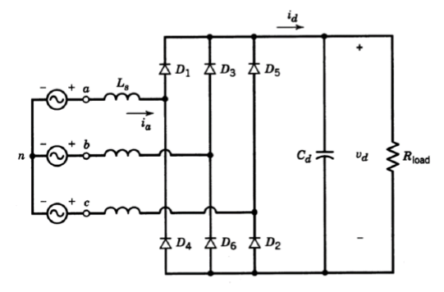
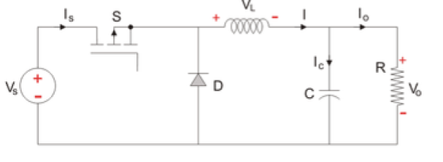
Three-Phase Diode Rectifier with Buck Converter

Slide 5
Three-Phase Diode Rectifier with Buck Converter
Advantages
Disadvantages
Three-phase diode rectifier takes grid AC voltage as input and gives DC voltage with decreased ripple as output.
Even though it consists of a rectifier and converter, this topology is less expensive than the topologies that contain thyristor.
Only one component needs a gate signal so the layout and synchronization is much simpler than the thyristor-containing topologies.
This topology is not suitable for operating in inverter mode

Slide 6
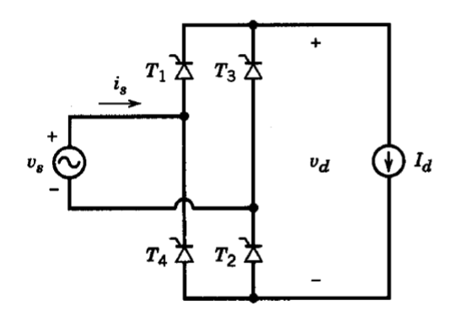
SIngle Phase ThyrIstor RectIfIer

Slide 7
SIngle Phase ThyrIstor RectIfIer
Advantages
Disadvantages
It contains four thyristors so it is less expensive compared to the three-phase thyristor version.
Since it has four thyristors, circuit layout and gate signal synchronization are simpler than in the three-phase thyristor case.
It can operate in inverter mode.
The output voltage can be fully controlled via the firing angles.
It costs higher than the three-phase diode rectifier with a buck converter.
The output voltage ripple is high.
The average output voltage is lower than the three-phase version.
In order to drive the thyristor without a problem, driver circuits are needed. This increases the layout complexity and costs extra components.
It causes the harmonic problems in input current.

Slide 8
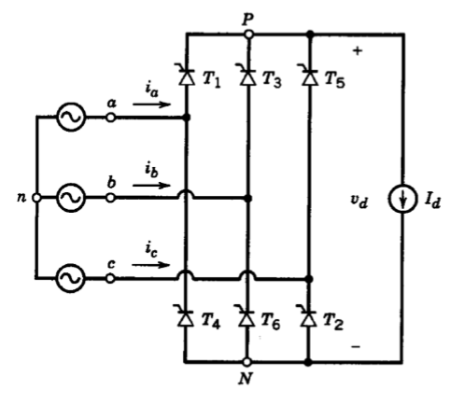
Three-Phase ThyrIstor RectIfIer

Slide 9
Three-Phase ThyrIstor RectIfIer
Advantages
Disadvantages
This topology results in a lower output ripple voltage compared to the single-phase case.
The output voltage is fully controlled.
The average output voltage is higher.
It is possible to use this topology in the inverter mode.
Since six thyristors are used, it is expensive.
As the thyristor number increases, gate signal complication increases as well.
Synchronization and simplification is harder.
The gate signals of thyristors should be given through drivers. This increases the complexity and cost.

Slide 10


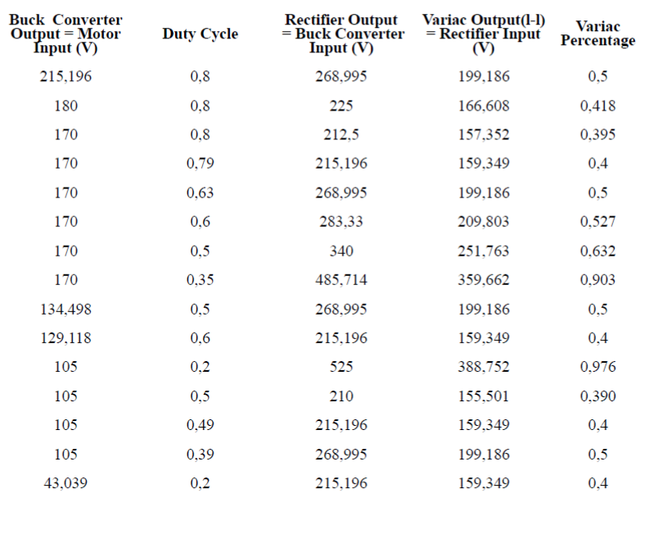


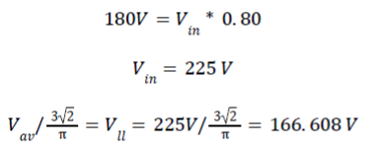
RectIfIer and Converter CalculatIons

Slide 11
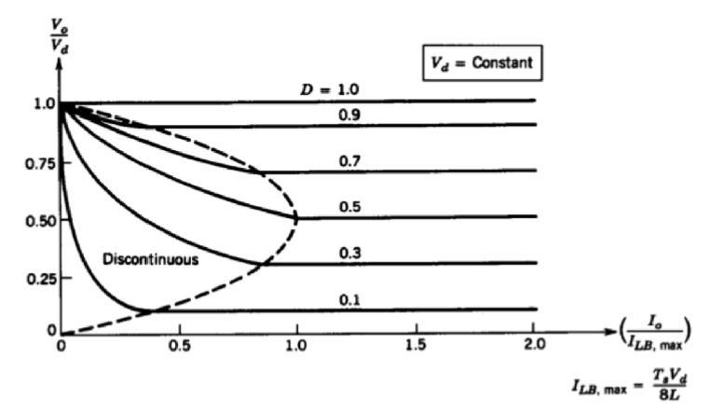
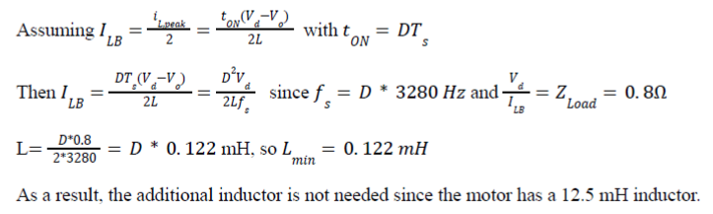

Slide 12
Power and Loss CalculatIons
At rated condition
τ loss = 1.66 N.m
At no load condition
200.68W loss due to friction
At kettle load condition
Total loss = 401.36W
At start-up

Slide 13
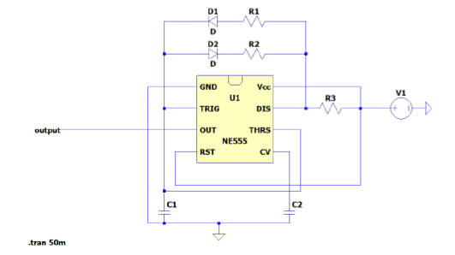
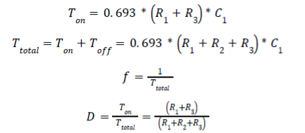
Calculation and Simulation of Timer

Slide 14
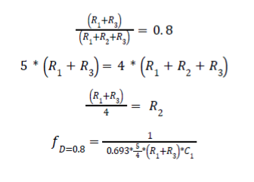
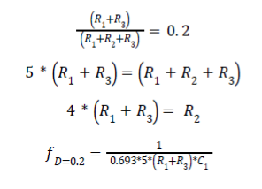

For D=0.2:
For D=0.8:

Slide 15
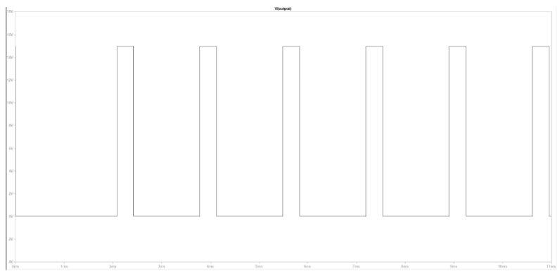
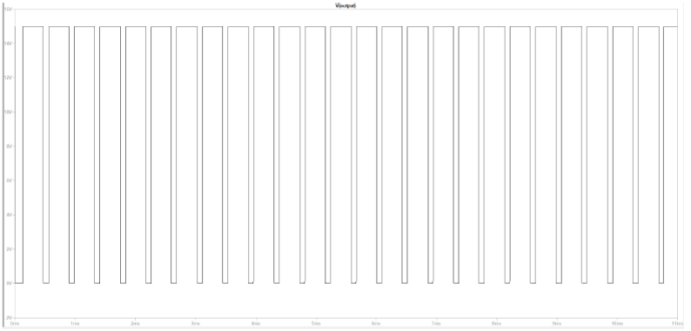

Slide 16
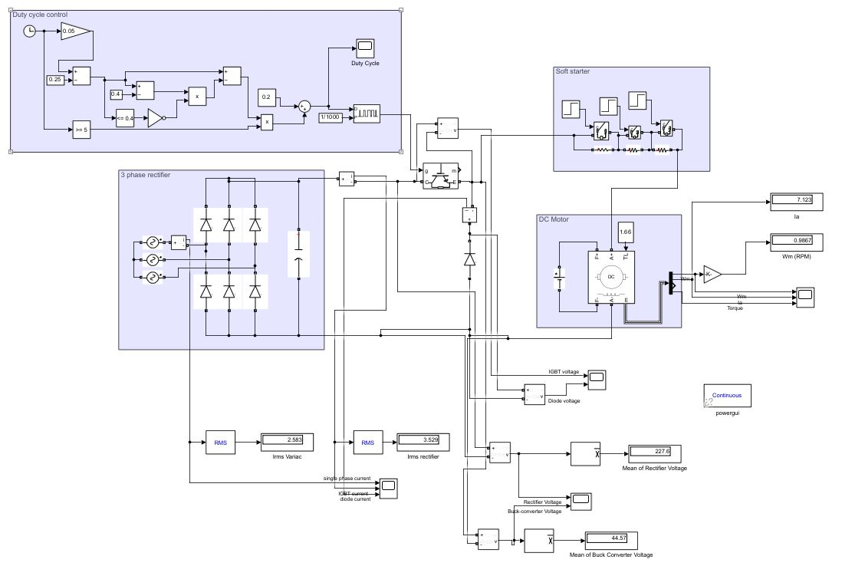
Simulation of the Selected Topology

Slide 17
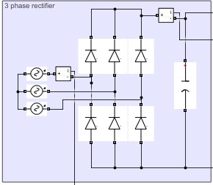
3 Phase rectıfıer

Slide 18
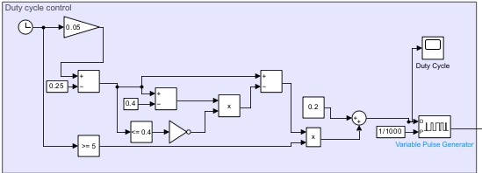
Duty cycle control

Slide 19
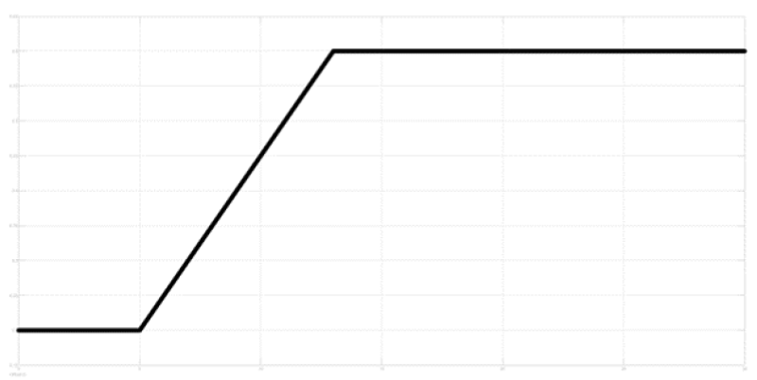

Slide 20
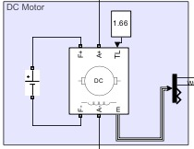
Dc motor

Slide 21
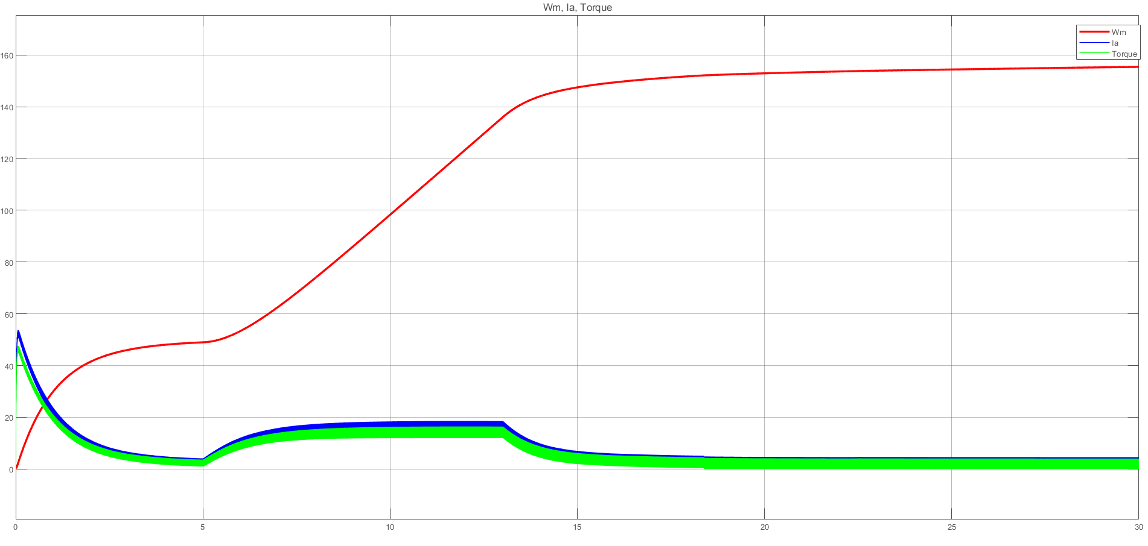
Wm, Ia, and Torque of the motor without soft starter, timespan 0 to 30 seconds

Slide 22
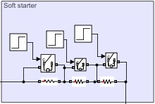
Soft starter

Slide 23
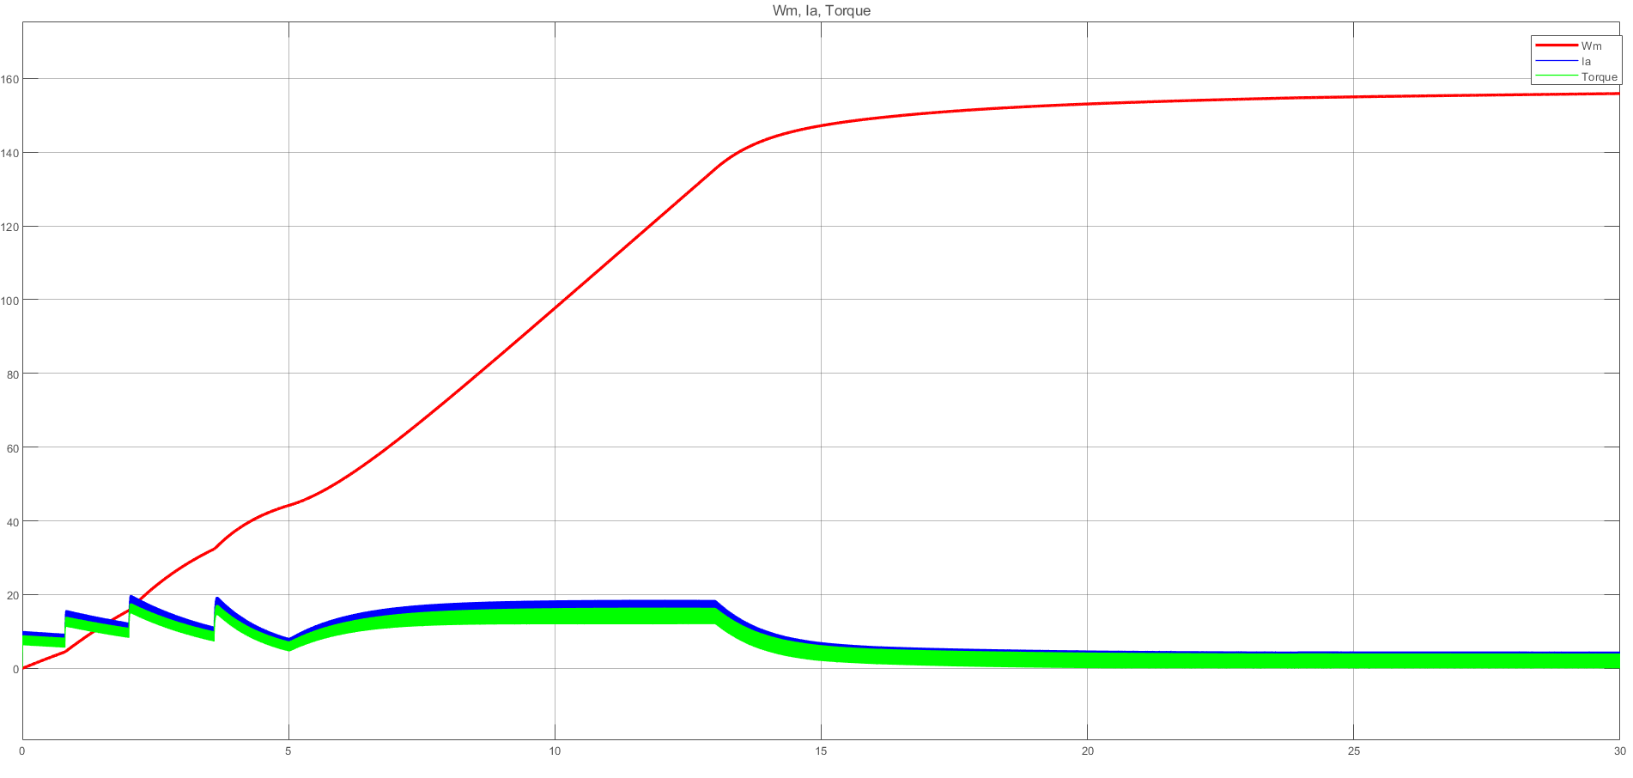
Wm, Ia, and Torque of the motor with soft starter, timespan 0 to 30 seconds

Slide 24
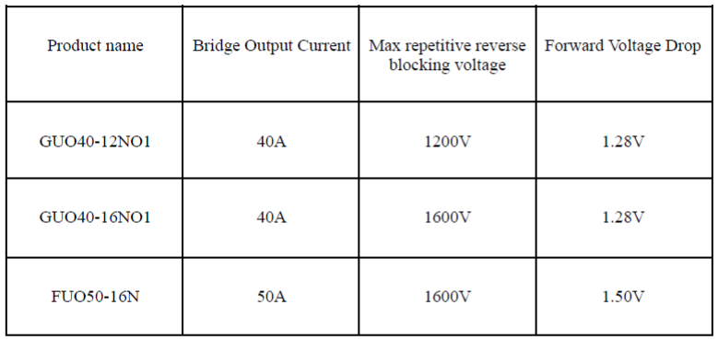
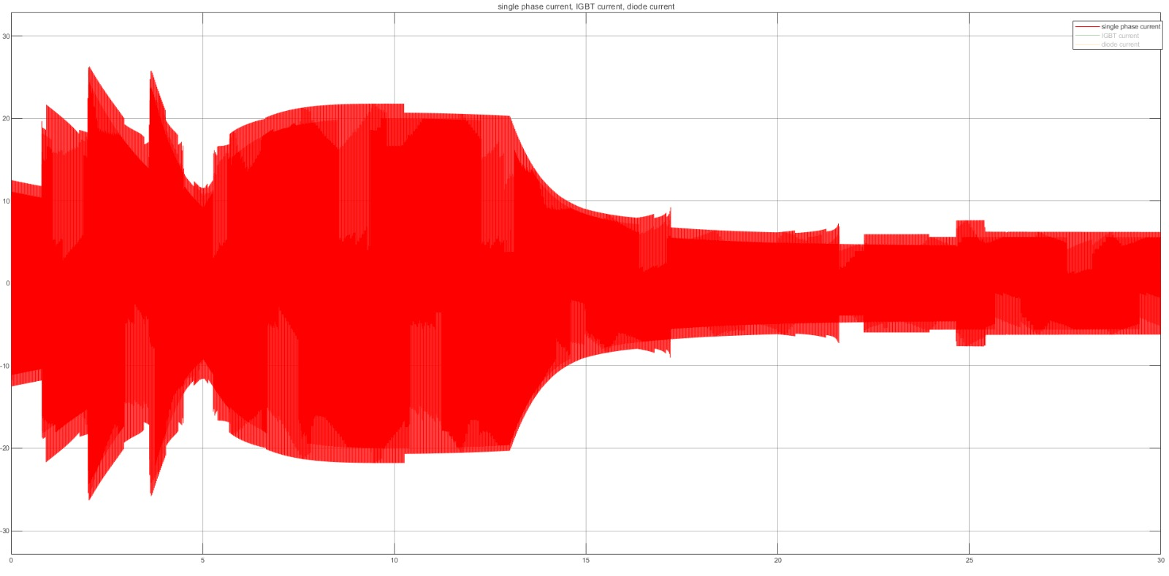
Bridge Rectifier

Slide 25
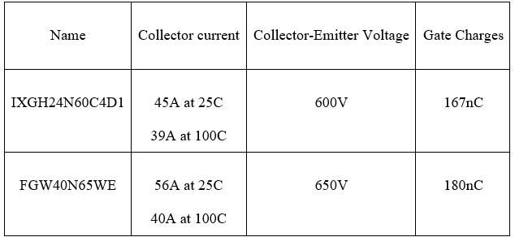
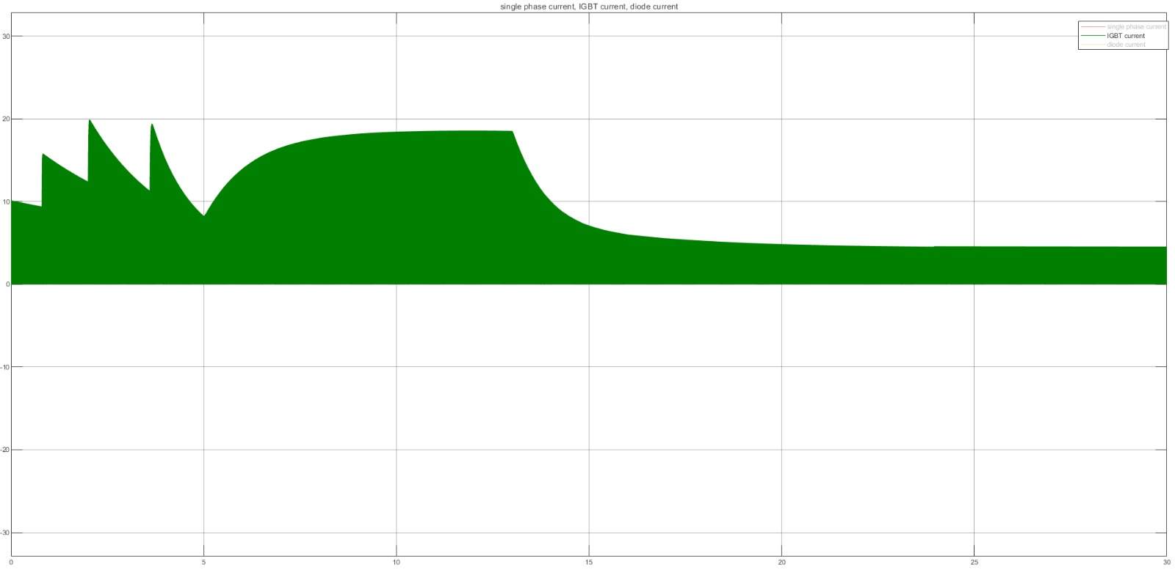
IGBT

Slide 26
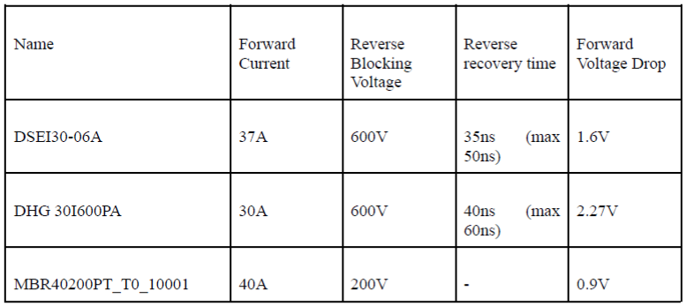
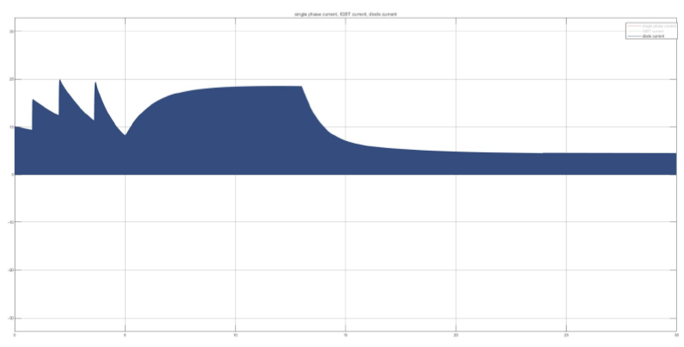
Diode

Slide 27
Capacitor
100μF capacitor
22V ripple
400V

Slide 28
Aımed bonuses
Tea Bonus
PCB Bonus
Industrial Design Bonus
Compactness Bonus
Single Supply Bonus
Analog Controller Bonus
Closed-loop Voltage/Current Control Bonus
Closed-loop Speed Control Bonus

